Slide 1
Blockchain, to nie sú iba virtuálne peniaze. Aké možnosti prináša v ére digitalizácie?
Martin Mrva
Notes:
mystical Satoshi Nakamoto late 2008 spomenut

Slide 2
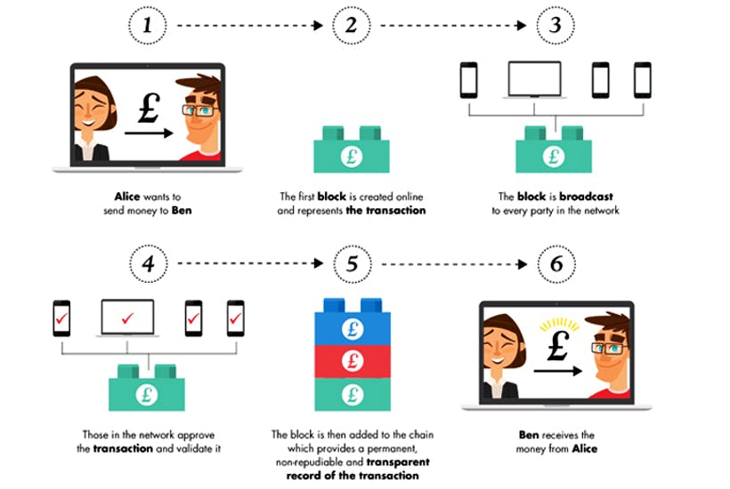
Ako to funguje.
Source: Spectator.co.uk
Notes:
Alice wants to send money to Ben
More transactions are gathered into one block
Block is created and broadcasted to the network
Network validates transaction (describe mining and consensus mechanism)
Block is added to the chain
Ben receives money
Double spending, decentralization, economic incentives to good behaviour, Tokenization of everything, transaction speed

Slide 3
Blockchain:
“THE TRUST MACHINE”.
Transparentný
Decentralizovaný
Nemeniteľný
Eliminuje sprostredkovateľov
Bezpečný
The Economist (2015)
Notes:
Transparentný - Blockchain is a Public List of Transactions’ Data
Decentralizovaný - Disruption of Middlemen
Nemeniteľný - Irreversible History of Transactions
Eliminuje sprostredkovateľov - Elimination of 3rd Party Costs
Bezpečný – Zatiaľ nehacknutý
Prechod na dalsi slide: Pre tieto vlastnosti sme sa uz pomerne skoro zacali zaoberat blockchainom aj my v DECENTE

Slide 4
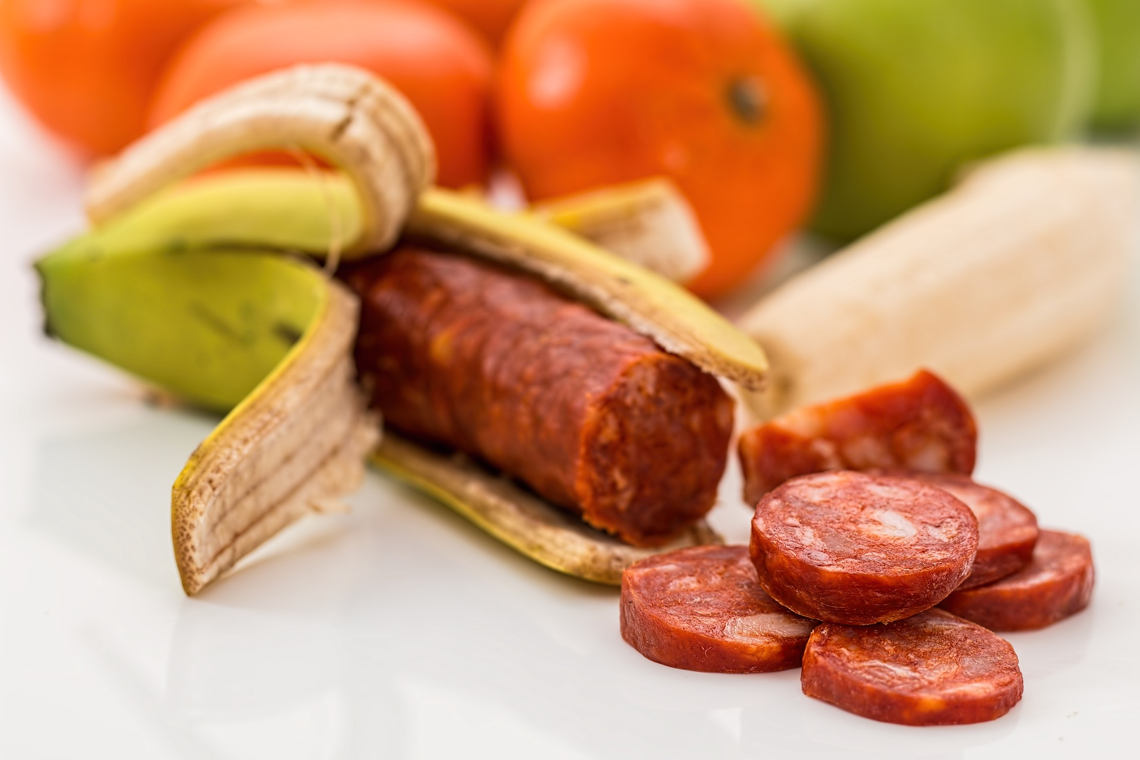
Notes:
mystical Satoshi Nakamoto late 2008 spomenut

Slide 5
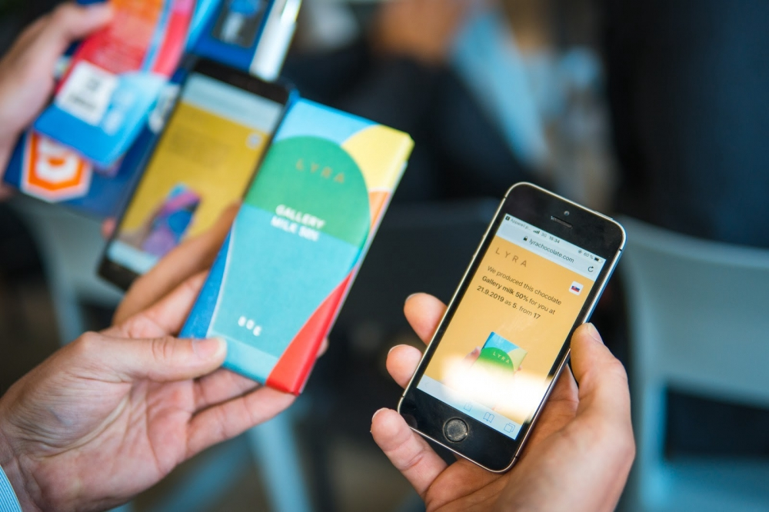
Notes:
mystical Satoshi Nakamoto late 2008 spomenut

Slide 6
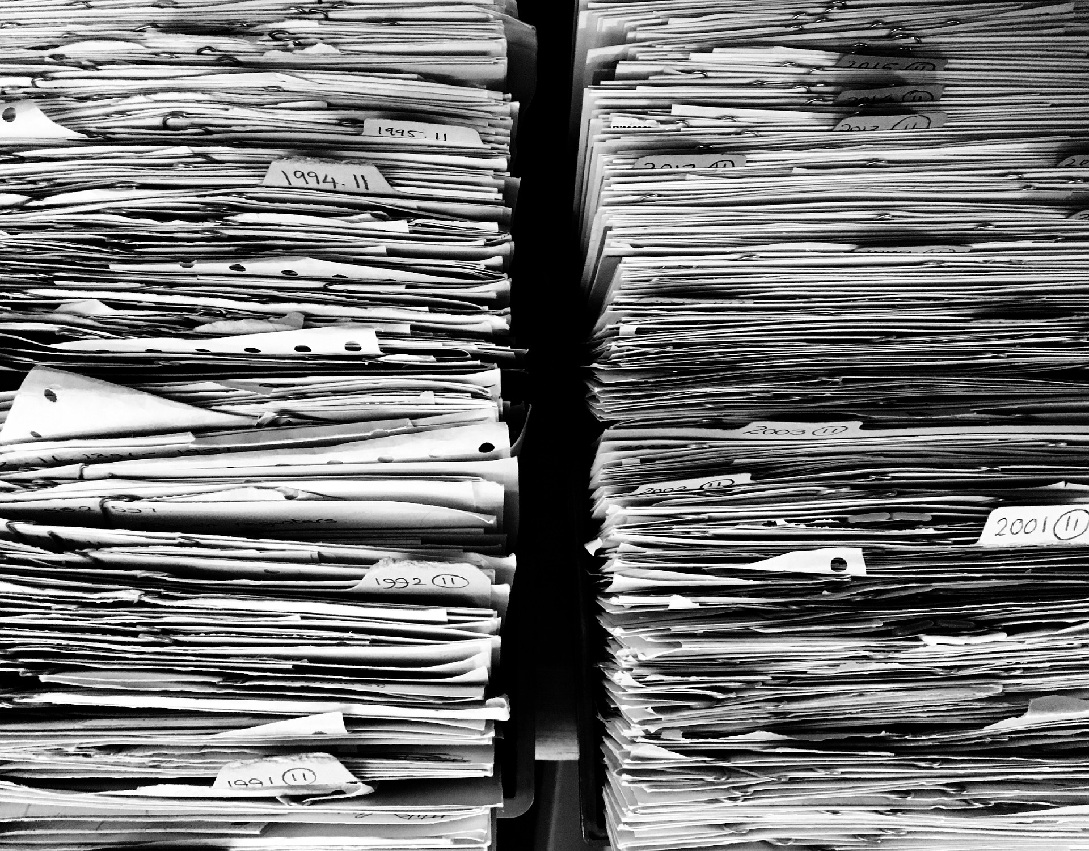
Notes:
mystical Satoshi Nakamoto late 2008 spomenut

Slide 7
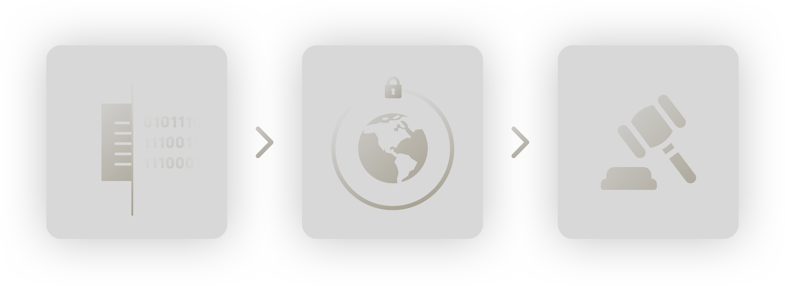
Notes:
A digital proof is created in the form of an immutable, timestamped data fingerprint
The file’s encrypted footprint is shared to an unhackable, secure worldwide database
The recorded proof can then be used in court as evidence

Slide 8
Contact us business@decent.ch martin.mrva@decent.ch
Martin Mrva
Notes:
mystical Satoshi Nakamoto late 2008 spomenut

