Slide 1
Digitalisation and circular economy insights from the recent OECD work
Dr. Eva Barteková
OECD Environment Directorate
Eco-Innovation Slovakia 2019
Bratislava, 5 November 2019

Slide 2
Outline
OECD’s work on digitalisation and the circular economy
  MCM 2019
  Going Digital II
  Digitalisation and the circular economy
Relevance of circular economy for tackling the environmental consequences of the growing global materials use
Importance of digitalisation for facilitating and scaling the transition towards a more circular and resource efficient economy

Slide 3
OECD’s work on digitalisation and the circular economy

Slide 4
Policy issues on digital transformation have now taken root on the OECD agenda
Meeting of the OECD Council at Ministerial level (MCM) 2019
  Policies for “Harnessing Digital Transition for Sustainable Development: Opportunities and Challenges”.
Going Digital Phase II
  Pillar 1: Horizontal activities relevant to all Committees participating in the project;
  Pillar 2: Thematic work on AI;
  Pillar 3: Thematic work on blockchain.

Slide 5
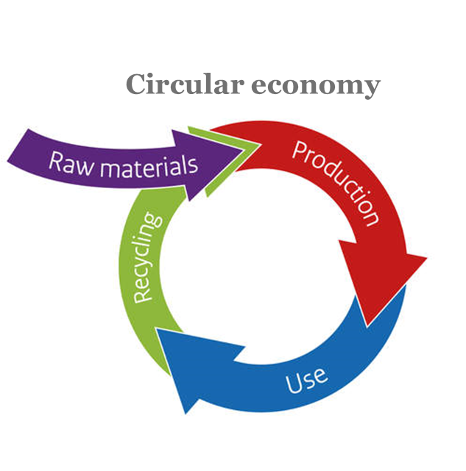
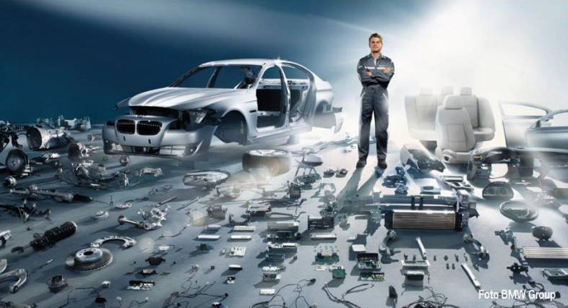
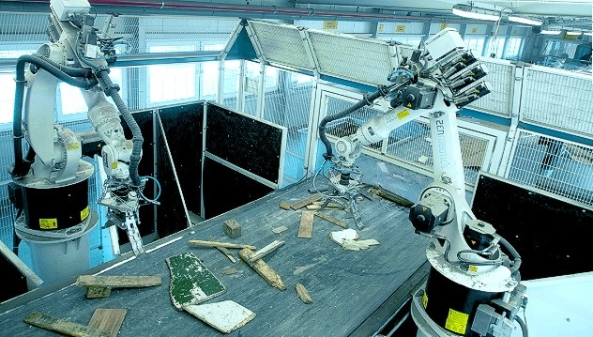

Digitalisation and circular economy nexus is the focus of current work at the Environment Directorate
Reusable assets and asset tracking
Robotic recycling
Online platforms for asset sharing
Source: OECD (2019, forthcoming), Digitalisation and the circular economy.

Slide 6
circular economy for tackling environmental CHALLENGES

Slide 7
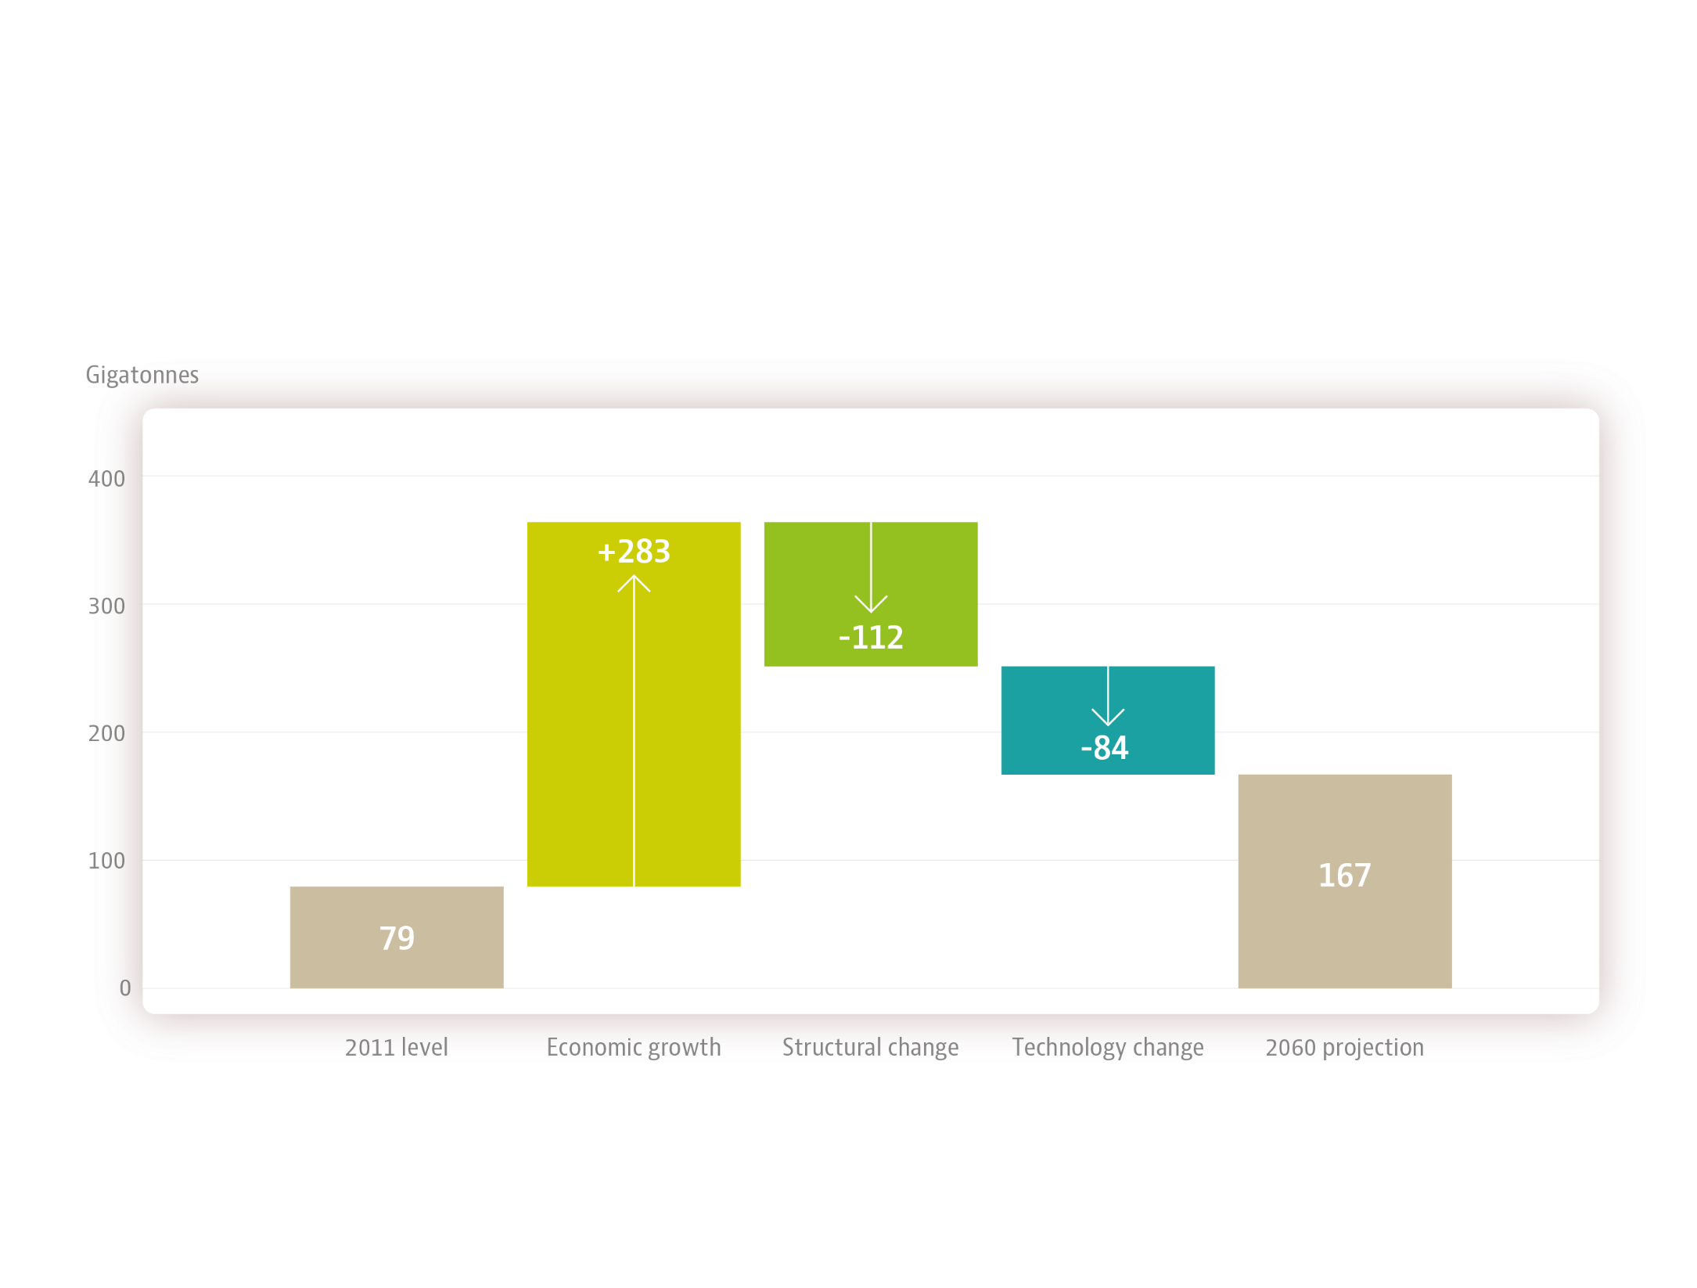
Competing forces lead to near doubling of materials use by 2060…
Source: OECD (2019), Global Material Resources Outlook to 2060.

Slide 8
… with severe environmental consequences
GHG emissions in CO₂ equivalent
12% of total ghg emissions associated with 7 key metals
12% of total ghg emissions associated with concrete
50Gt CO2 eq emissions associated with materials cycle
Source: OECD (2019), Global Material Resources Outlook to 2060.

Slide 9
Circular economy can help mitigate the pressing challenges around material consumption and its environmental impacts
Increased resource productivity
Slower material loops
Increased product lifespan (e.g. through eco-design, re-use or repair)
Material loop closing
Increased product, repair and remanufacture
Increased material recycling and recovery
Modified consumer preferences
Increased asset utilization
Increasing material efficiency
Source: McCarthy, Dellink, Bibas (2018), The Macroeconomics of the Circular Economy Transition.

Slide 10
Digitalisation for scaling the transition towardS THE circular economy

Slide 11

Digitalisation makes physical assets more intelligent
Internet of Things (IoT)
Big data and analytics
Artificial Intelligence (AI)
Blockchain
Cloud computing
Online platform
3D printing (additive manufacturing)
Photo source: dynamisdigital.com

Slide 12
Intelligent assets generate information flows, which drive the creation of new economic opportunities …
Digitalisation allows to:
  Collect, manage and process data, information, and knowledge;
  Facilitate data-driven decision making;
  Create and capture value in new ways throughout assets’ use cycles.
Availability and flow of information drives scalability of circular activities:
  Components availability, material compositions and specifications;
  Products’ and services’ accessibility, location, and condition;
  Consumer preferences and behaviours;
  Efficiency of process management;
  Matching skills and partnerships.

Slide 13
… and help overcoming barriers to scaling up the circular economy
  Condition and availability of components and products
  Composition of waste streams
  Quality of secondary materials
  Finding and bargaining with customers and suppliers
  Uncertainties related to waste generation and composition
Imperfect information
Transaction costs
Market failures
Technological externalities
Consumption externalities
  Resource recovery
  Decentralised manufacturing of components and final products
  Quality of final goods produced from secondary raw materials
Source: OECD (2019, forthcoming), Digitalisation and the circular economy.

Slide 14


























Digital technologies thereby help addressing market failures in private sector, …
Imperfect information
Transaction costs
Market failures
Technological externalities
Consumption externalities
Source: OECD (2019, forthcoming), Digitalisation and the circular economy.

Slide 15
… can be leveraged by policy-makers to create greater efficiencies, improve sustainability and spur economic development, …
Policy and data analysis
  Access to large volumes of data to identify priority areas and make informed decisions
  - Modelling for better urban planning.
Policy design and reshaped government-citizen interaction
  New instruments to experiment with more effective design and evaluation of policies
  - Volume-based waste charging, smart waste collection.
  Better engagement of citizens in policy making
  - Digital public consultation of environmental strategies.
Improved implementation
  Direct monitoring of outcomes for more effective enforcement of existing policies
  - Online reporting of hazardous waste shipments, electronic waste tracking.

Slide 16
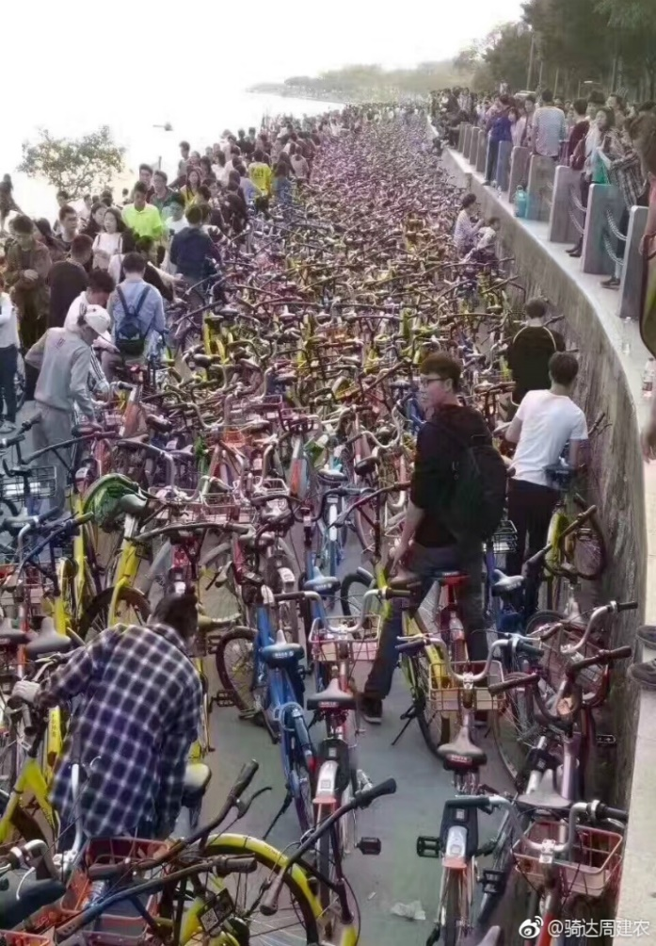
… but can also fundamentally challenge some of the long-standing approaches across public policy domains
Challenges to digital technologies:
  Data security, privacy, ownership, transparency, use;
  Environmental implications of scalability of digital technologies.
Unintended consequences of digital circular economy:
  Environmental;
  Social;
  Economic;
  Regulatory.
Photo source: www.businessinsider.com.au

Slide 17
Therefore, policy action is needed to unlock further opportunities and avoid unintended consequences
Need for an enabling framework that facilitates digitally enabled circular activities, while mitigating risks.
Key elements of proposed policy framework:
  Address systemic risks of digital technologies;
  Support development of circular economy relevant digital applications;
  Support development of standards and harmonised data protocols;
  Address risks linked to unintended consequences of circular economy scale-up.
Need cross-sectoral policies as well as international co-ordination.

Slide 18
Thank you for your attention
Eva Barteková
eva.bartekova@oecd.org

