Slide 1
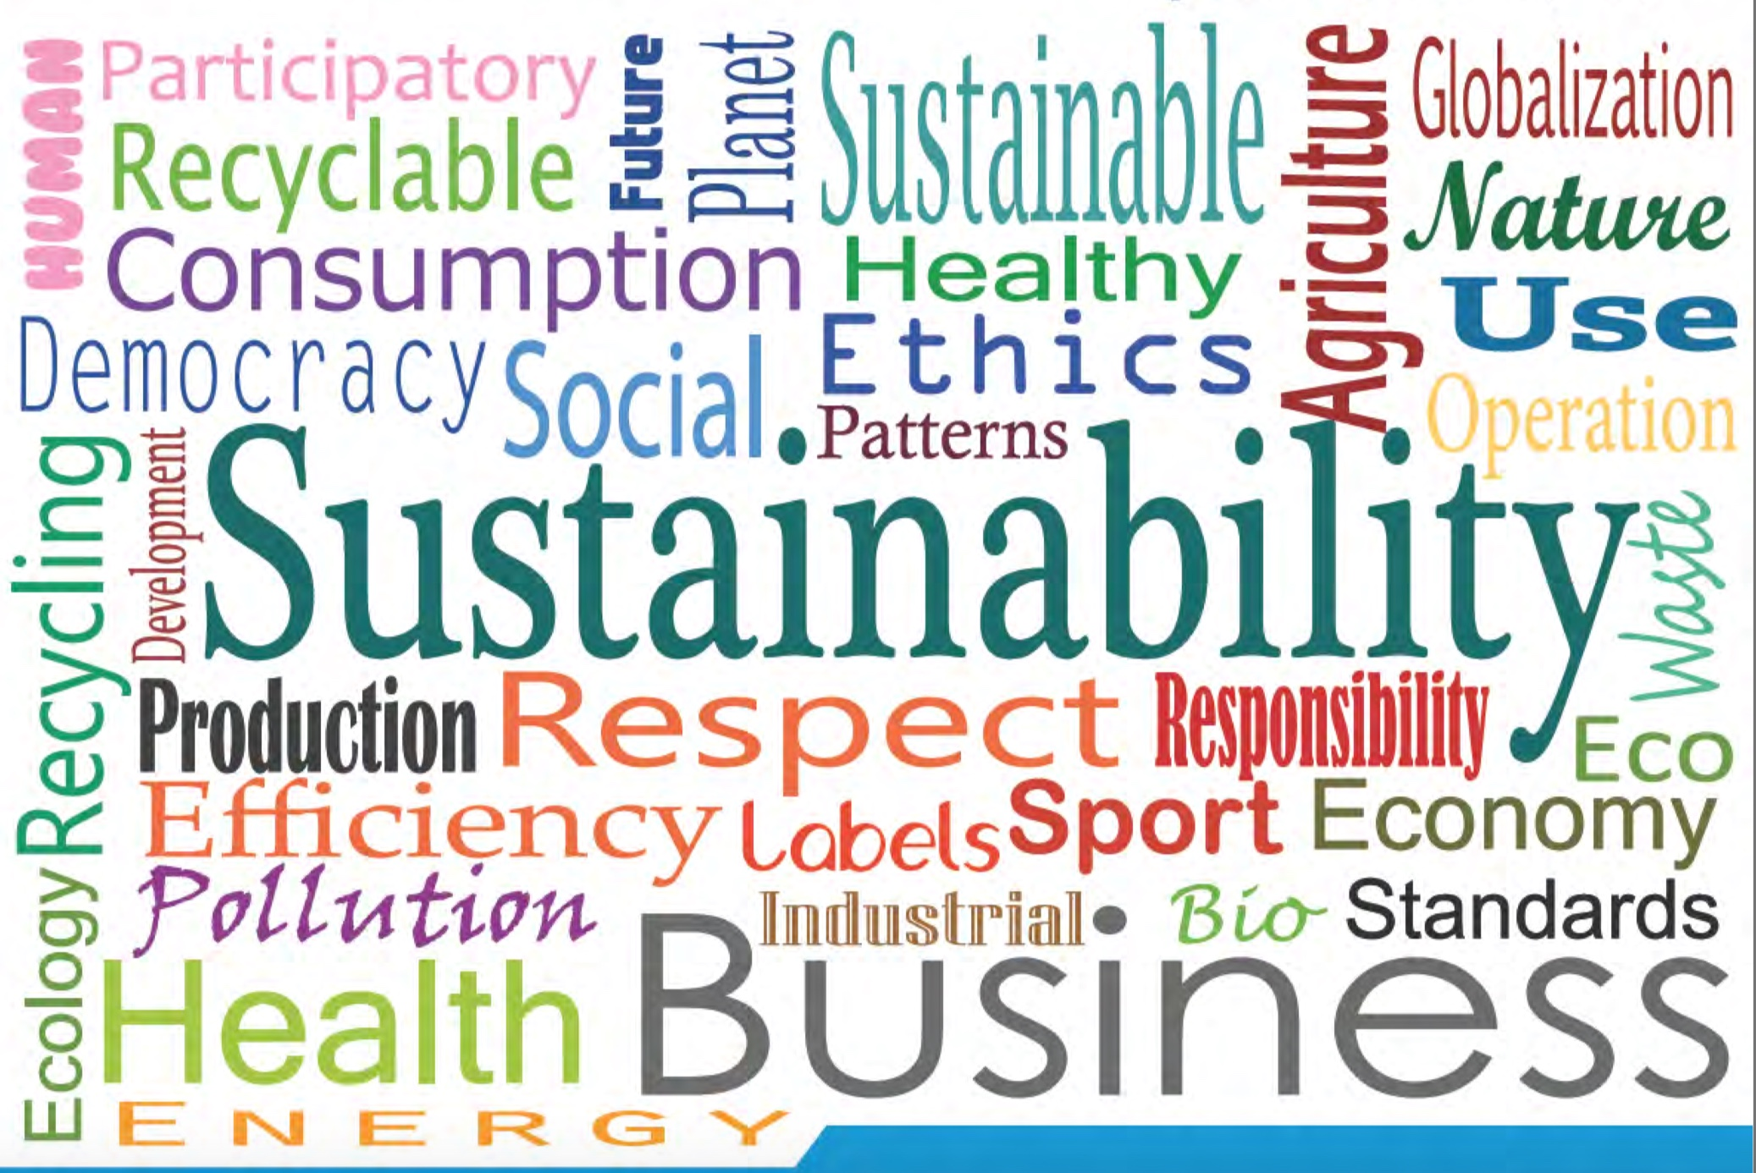
EMASeasy: Managing Sustainability V.4.0 in the new economy

Slide 2

Challenge : Transmission-Transition-Innovation
Business of tomorrow…
…is not only about products
…is not only about processes
... it is not only about money
It will be more and more about the way how business is done
It will be about
Environmental protection
Transparency
Accountability
Fairness and ethics
Resource efficiency
Circular economy
Social innovation
+ create intangible assets

Slide 3
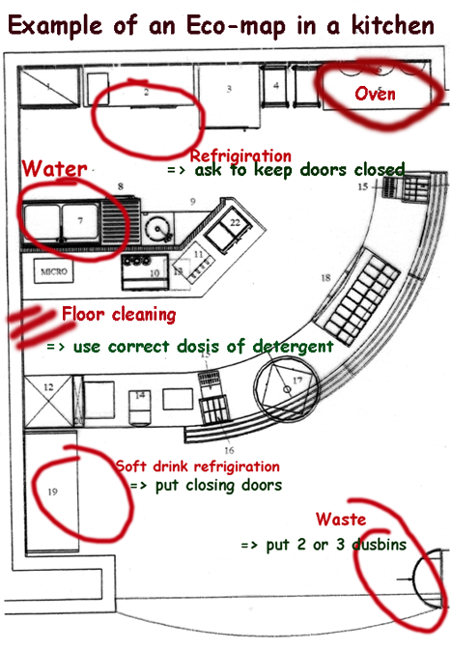
Ecomapping is the starter Kit for ….
A visual and participatory tool to:
Improve environmental protection
Scan environmental impacts, problems and practice in SMEs in a participatory process of learning
Use several ECOmaps in order to facilitate and visualize environmental problems (“hot spots”) within a company
Jump start an immediate environmental action programme
Collet and communicate relevant data
Facilitates visual and focalised inspection, improvement and involvement at all levels
Covers 80 % of EMAS regulation

Slide 4
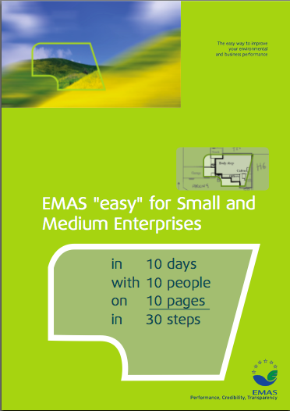
EMASEASY© –EMS TOOL FOR SMEs
Two most significant challenges – cost and lack of the appropriate human resource
The author of EMASeasy, Heinz-Werner Engel, has set out to provide a process through which small and micro-businesses can educate and involve their staff in their environmental issues, keep the bureaucracy of the process to a minimum, utilize support from and offer support to other partners in any cluster and win certification to ISO 14001 or registration to EMAS in a short and manageable time frame.

Slide 5
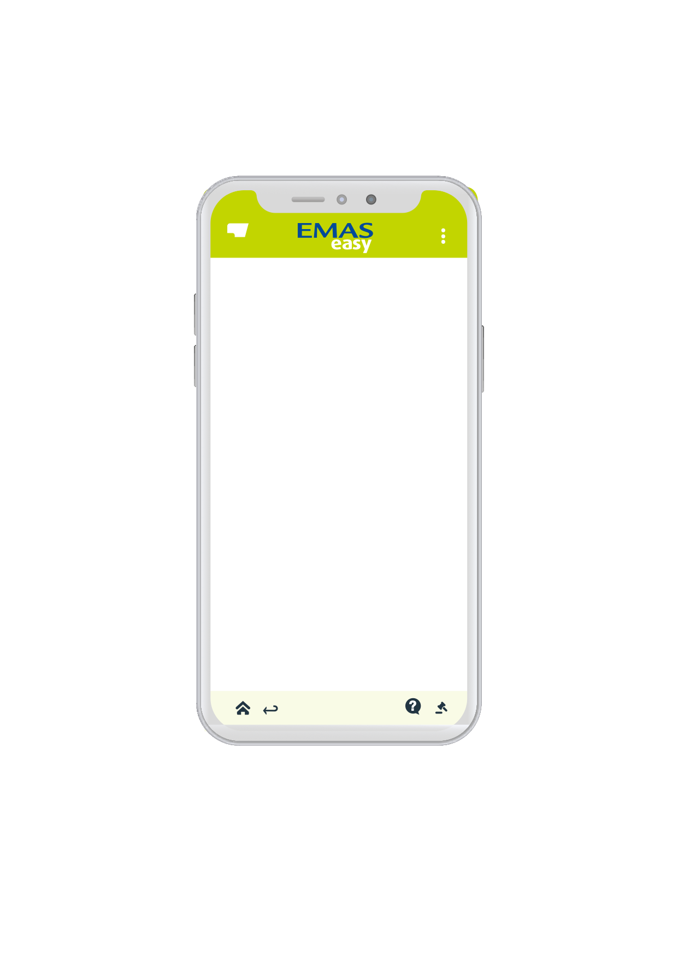








Less consulting - more consultation - collective - Intelligence
    Engaging an SME in sustainable management and reporting costs a fortune
    Consultants
    Internal bureaucracy
    Staff time
    External certification cost
    Reduce costs by 90%
    of any classic approach

Slide 6
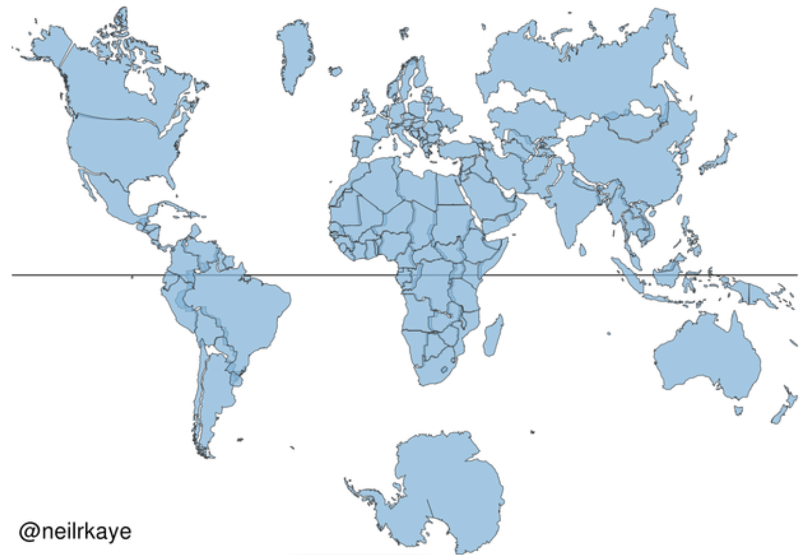
SME Starter Kit - SDG - Impact
Ecomapping is used in more than 80 countries

Slide 7
Digitalize Classic Tools:
Robust Simple Clever
Ecomapping since 21 years
Global uptake and proven
Adapted and integrated into variety of settings and frameworks
Very popular
More widely used than ISO environmental standards
EMAS easy since 15 years
Widely used in different settings
New developments : Energy , Fair Trade , Biodiversity Governance Integration of ISO Cluster Competivity of SME’s Climate change
Experience repertory benefits future development

Slide 8
Sustainability management V.4.0 Update Upgrade Innovate
Digitalize the entire underlying processes of sustainable management in small SME’s and external stakeholder involvement + communication
Develop joint projects to link proven concepts with disruptive modern technologies ( AI Block the chains )
Empower young in mind and future consultants, coaches and professionals
Transform Ecomapping and EMAS easy to the level of industry V.4.0
Design : Intuitive - More simple – cool –user friendly

Slide 9

Blockchains for Emas & Certifications
Your transparency vehicle
Social trust
Reduce audit transaction costs
Lower Footprints
Decentralise registration
From Shop floor to EU
By design, blockchain’s are inherently resistant to modification of the data.
A blockchain is "an open, distributed ledger that can record transactions between two parties efficiently and in a verifiable and permanent way

Slide 10
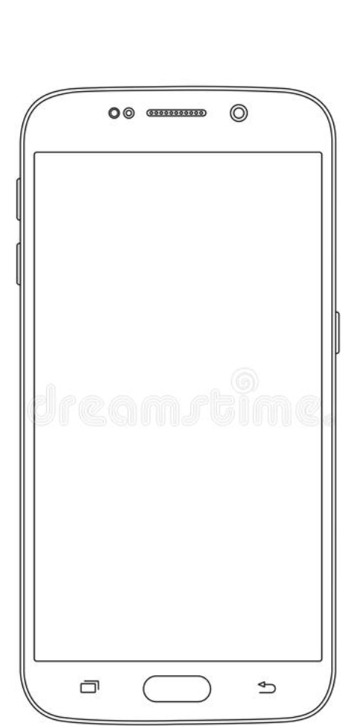
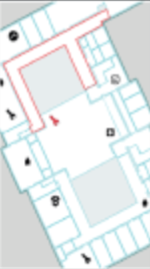
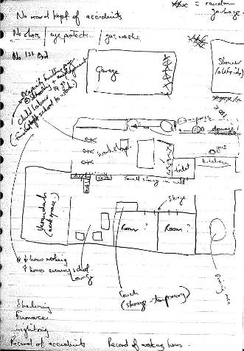
Informal: Shop Floor Practice Hot spots

Slide 11

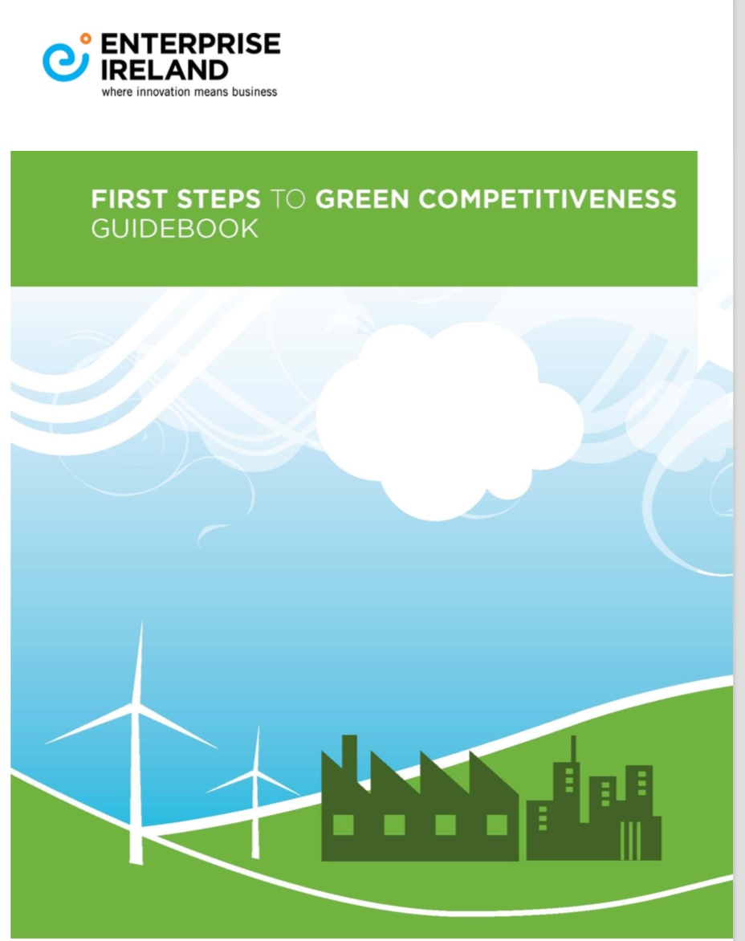
Compliance EMAS ISO etc
From paper- excel-online - into smart systems

Slide 12
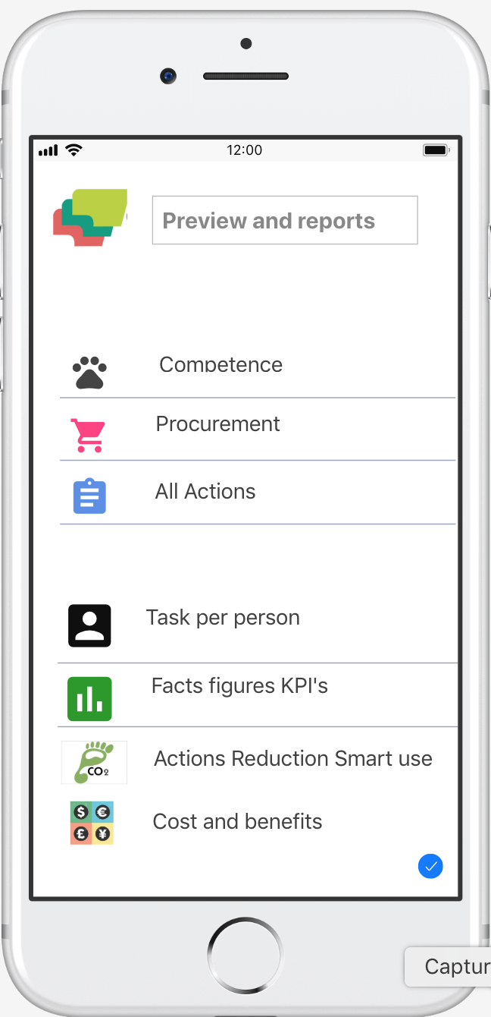
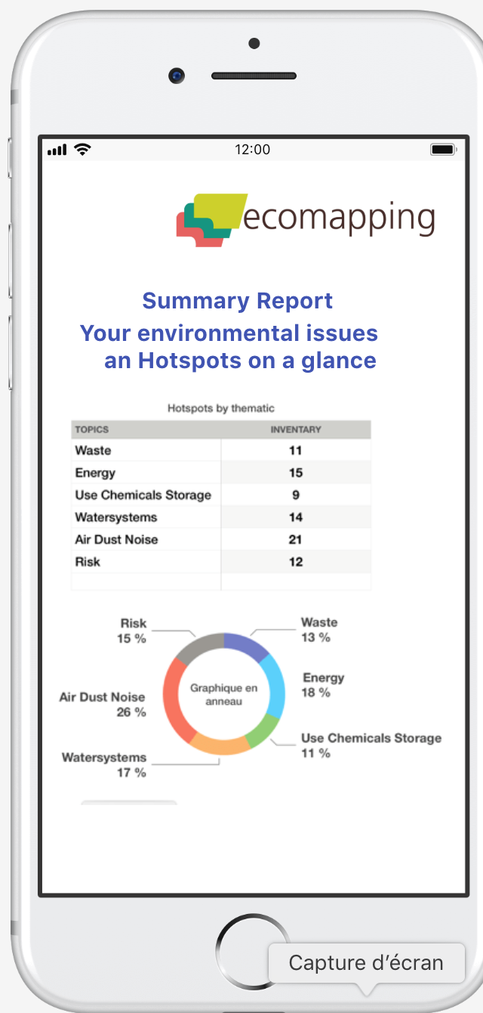
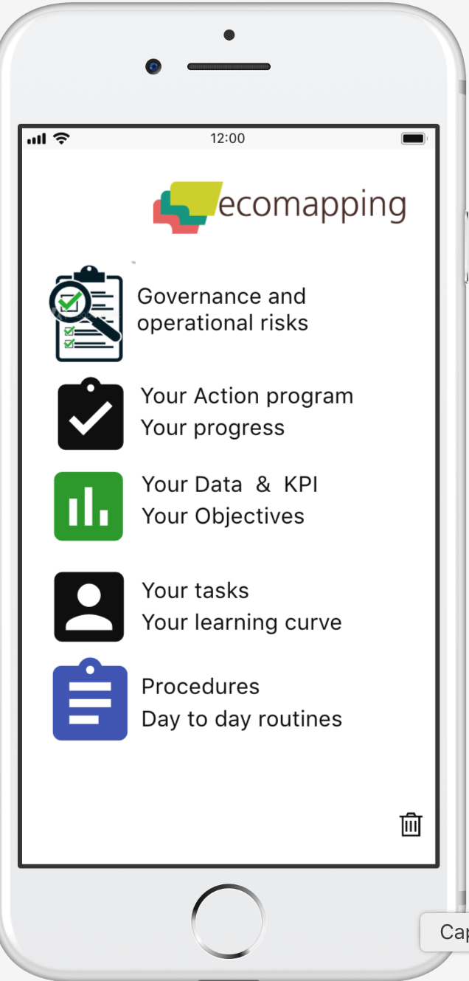
Features Reporting Visualisation Dashboards
© H W Engel

Slide 13
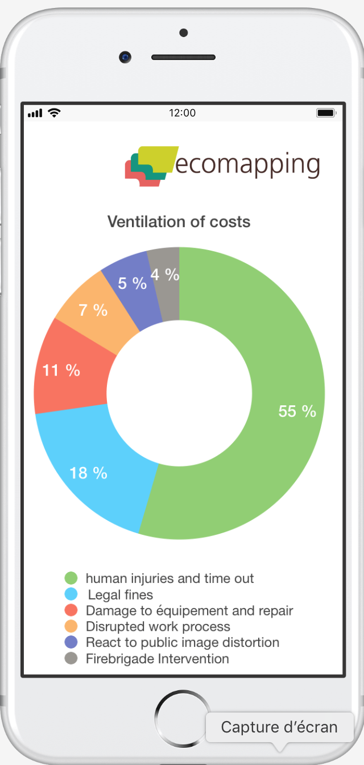
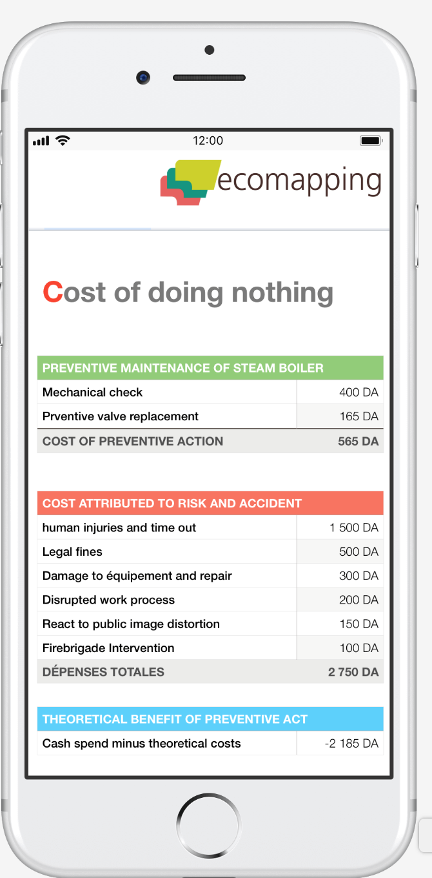
Pre Visualisation Cost of Doing and doing nothing
© H W Engel

Slide 14
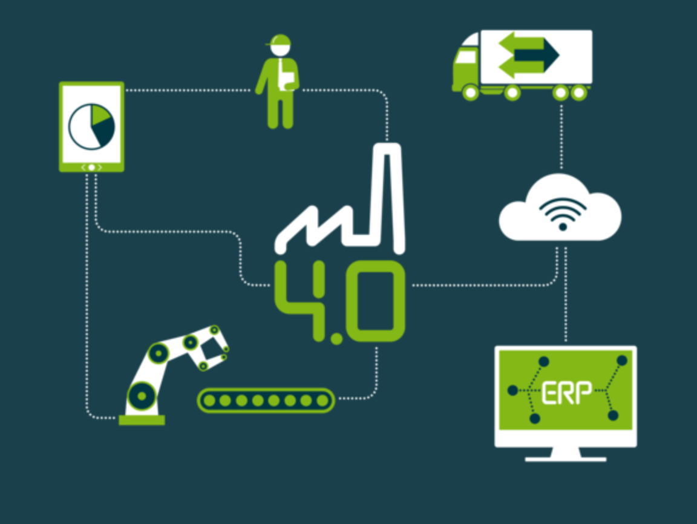
Urgent Innovation needs
From writing to visual oral communication
Block chains technology for certification processes and claims in value chains
Use digital Ecomapping as starter kit to generate implicit and factual knowledge and generate action
Embed Ecomapping in TVET worldwide
Use cellphones as collaborative tool
Inclusive - extensive participatory communication features
Cross cultural fitness

Slide 15

Ing.Roman Gdovjak
Slovak Environment Agency
roman.gdovjak@sazp.sk

