Slide 1
Energy – efficient cloud computing services: policy options for Green Public Procurement
Francesca montevecchi senior expert – Circular economy
Environment Agency Austria (Umweltbundesamt Gmbh)

Slide 2
EC Study on energy efficiency of cloud computing
“Energy-efficient Cloud Computing Technologies and Policies for an Eco-friendly Cloud Market”
https://www.cloudefficiency.eu/home
Commissioned by DG CONNECT to:
Environment Agency Austria
Borderstep Institute for Innovation and Sustainability (DE)
Objectives:
To assess the current and future energy consumption and state-of-the-art of cloud computing services in Europe, and to propose recommendations for energy-efficient cloud computing, particularly in relation to future research and development, Green Public Procurement and market policies.

Slide 3
Project Outline
Analyse and model across the EU28 the energy consumption of the cloud computing data centre infrastructure and forecast by 2025. Future scenarios digitalization.
Technological analysis for providing full cloud computing services
Policy analysis of current approaches for stimulating or imposing eco-friendly procurement, use and provisioning of digital technologies.
Research and technological development identifying key technological areas.
Green Public Procurement (GPP): compile and analyse the impact of existing schemes and recommend policy options for cloud computing services.
Providers of cloud computing services: compile, analyse and recommend policy options for stimulating the provisioning of energy efficient cloud computing services.

Slide 4
Problem framing
In recent years, the demand for data centre services has grown exponentially as the cloud model is expanding.
This has contributed to the consolidation of larger data centres, and studies predict a sharp increase in energy demand for cloud services.
The importance of this topic has also been underlined by the European Commission, and further developments in this area will be crucial in order to deliver a European Digital Single Market.

Slide 5
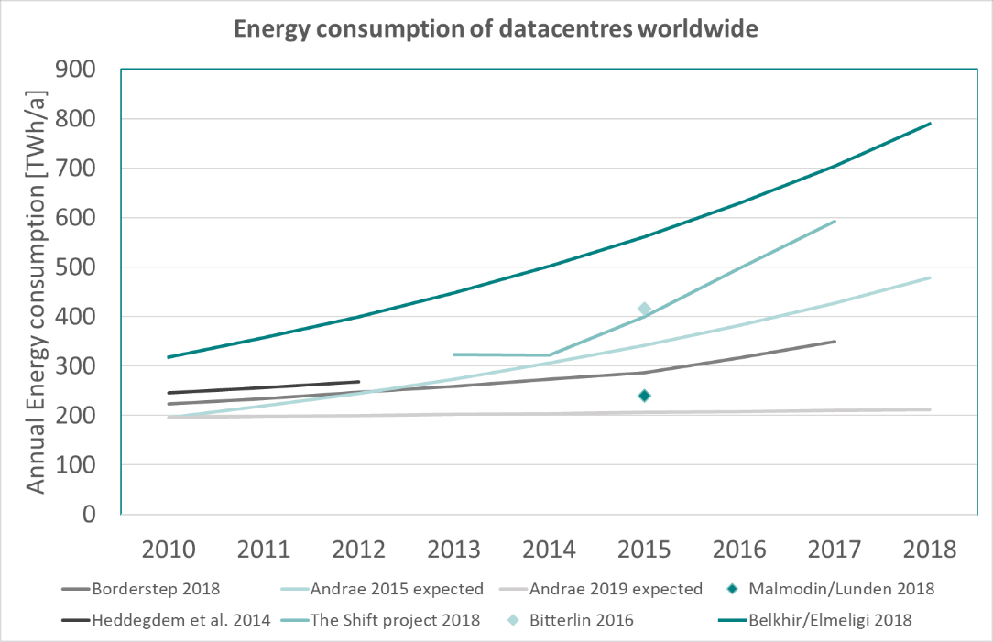
Current situation

Slide 6
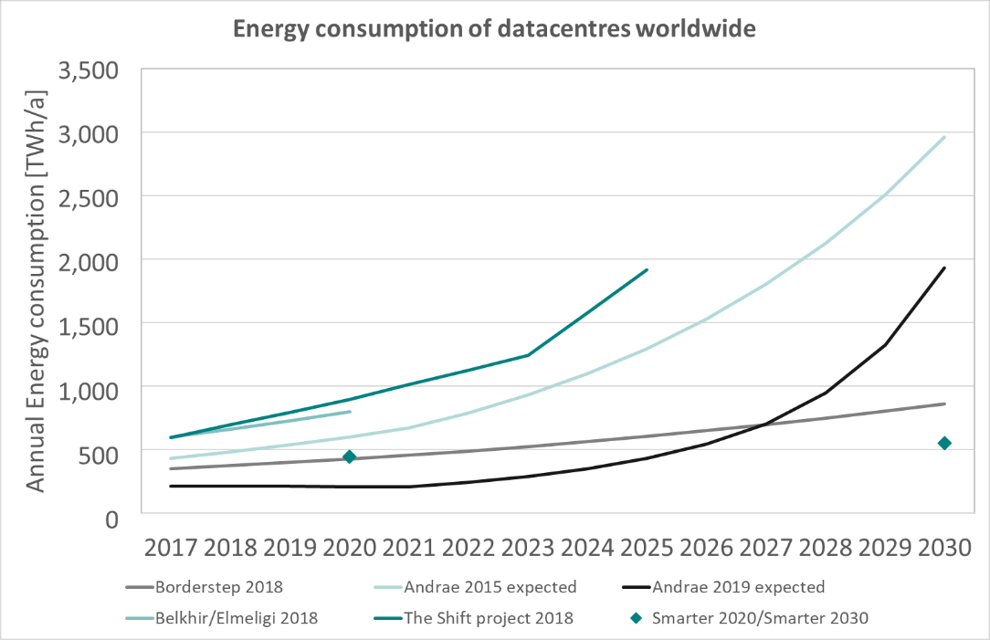
Future projection

Slide 7
GPP and energy – efficient cloud computing
Existing initiatives and policy instruments
Best practices examples
Highlights
The role of innovation and ways forward
The role of digitalization in future GPP

Slide 8
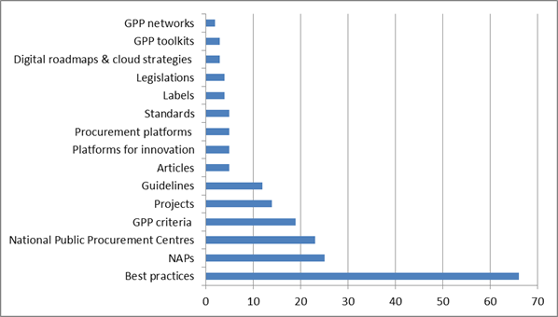
Existing policy instruments for GPP and energy efficient cloud computing services Analysis of different typologies of initiatives

Slide 9
Best practices
The EU Code of Conduct of Data Centres
The EU GPP Criteria for Data Centers and Server Rooms
→ But yet no criteria are included in National Action Plans/ at the MS level !

Slide 10
Best practices
Ecolabels
The Blue Angel (Der Blaue Engel)
The ENERGY STAR (expired on February 20th 2018)
Standards
ITU-T L.1301 – Minimum data set and communication interface requirements for data centre energy management
ITU-T L.1300 – Best practices for green data centres
ITU-T L.1302 – Assessment of energy efficiency on infrastructure in data centre and telecom centre
ITU-T L.1303 – Functional requirements and framework of green data centre energy-saving management system
ITU-T - L.1320 - Energy efficiency metrics and measurement for power and cooling equipment for telecommunications and data centres.
ITU-T - L.1321: Reference operational model and interface for improving energy efficiency of ICT network hosts
ITU-T - L.1325: Green ICT solutions for telecom network facilities
ITU-T R - L.1501: Best practices on how countries can utilize ICTs to adapt to the effects of climate change
https://www.itu.int/en/action/climate/Documents/ITU-TRecGreenDataCentre.pdf

Slide 11
Research Projects
CloudWATCH2 (Think Cloud Services for Government, Business and Research)
PICSE project (Procurement Innovation for Cloud Services in Europe)
Ascetic project (Adapting Service lifeCycle towards EfficienT Clouds)
ICT Footprint EU project
Helix Nebula project aimed at paving the way for the development and exploitation of a Cloud Computing Infrastructure IT-intense scientific research organisations
EURECA A toolkit for sustainable procurement for data centres

Slide 12
User cases
Excess heat from servers to warm households - Digiplex and Stockholm Exergi, Sweden
Keywords: reuse of heat, district heating, public private partnership, public procurement
Website: https://www.ictfootprint.eu/en/digiplex-and-stockholm-exergi-sweden
Heat reuse for district heating – the Yandex data centre Finland
Keywords: reuse of heat, district heating, public private partnership, public procurement
Website: https://www.greendatacenterplatform.com/project/royal-haskoning/
Telia Helsinki Data Centre, Finland
Keywords: renewable energy, data centres, district heating
Website: https://www.greendatacenterplatform.com/project/royal-haskoning/
Energy- efficient Centre for Scientific Computing Goethe University Frankfurt - Germany
Keywords: super computers, universities, renewable energy, waste to energy, passive cooling, data centres
Website: https://www.ictfootprint.eu/en/goethe-university-frankfurt-germany

Slide 13
User cases
Sustainable Data Centres in Linköping, Sweden
Keywords: renewable energy, public procurement, city data centres
Website: https://www.ictfootprint.eu/en/link%C3%B6ping-sweden
Energy- efficient genomics in the Earlham Institute, UK
Keywords: carbon- neutral data centre, genomics, big data analysis, Iceland
Website: https://www.ictfootprint.eu/en/earlham-institute-uk
Free- cooling system for data centres in Coimbra University, Portugal
Keywords: free cooling, universities, data centres
Website: https://www.ictfootprint.eu/en/university-coimbra-portugal
Optimizing data centres for public organization- GreenServe, Netherlands
Keywords: server virtualization, public organizations, server & data centres
Website: https://www.ictfootprint.eu/en/greenserve-netherlands
GreenConcept Project - France
Keywords: capacity building, eco-design in digital services, awareness raising, SMEs
Website: https://www.ictfootprint.eu/en/greenconcept-project-france

Slide 14
Highlights: user cases analysis
Implementation of green data centers all across the EU
Some are implemented by public organizations, whereas others are implemented by private companies.
Best practices include a variety of approaches such as:
More efficient cooling systems
Heat reuse, e.g. for district heating
Virtualization of software, optimal use of the capacity of the servers
Energy-efficient genomics
Eco-design for the efficiency of the infrastructures
Employment of renewable energy to supply data centers
Construction of data centers in naturally cold areas

Slide 15
Gap analysis
Lack of inclusion of GPP Criteria for energy efficient cloud computing in NAPs and national Criteria for Cloud Computing
Lack of criteria for energy-efficient cloud computing other than for Data Centres and Server Rooms
The topic is not included in the National Agendas for Cloud Computing , e.g. in National Digital Agendas
Public procurement of energy efficient cloud computing services is not a mainstream topic in EU platforms for GPP, SPP, etc.
No best practices have been found on the energy efficiency of cloud services in a broader sense, for instance focusing on the different cloud services deployment models (SaaS, PaaS, IaaS). With this regard, it seems that the topic is still at a very early stage of discussion

Slide 16
The role of innovation and ways forward
Criteria as the best way to promote energy efficiency of cloud computing in GPP?
Potential role of public procurement of innovation
Need for better metrics for data centres measurement and cloud computing in general, e.g. for implementing standards and labels
The role of awareness!! (e.g. video streaming)
What about everything what is NOT data centres and server rooms? e.g. energy efficiency of networks and applications?
Role of a digital tax
EU Cloud Infrastructure

Slide 17
The role of digitalization of future GPP
Big data management (research – gemonics – healthcare)
Public Administration will move into the Cloud → growing demand for cloud services. Joining forces?
Digital services of the future will rely on the cloud (e.g. Smart Buildings , Smart Infrastructure, Autonomous Driving) → how should GPP respond to that?

Slide 18
The role of digitalization of future GPP
Big data management (research – gemonics – healthcare)
Public Administration will move into the Cloud → growing demand for cloud services. Joining forces?
Digital services of the future will rely on the cloud (e.g. Smart Buildings , Smart Infrastructure, Autonomous Driving) → how should GPP respond to that?

Slide 19
Workshop : GPP and policies for energy efficient cloud computing
December 4th, 2019 Brussels
During the workshop, relevant stakeholders will come together to validate the proposed recommendations and to deliver valuable input, which will contribute directly to shaping the formulation of policies and practices for energy-efficient cloud computing services in Europe
Register :
https://newsletter.umweltbundesamt.at/Event/Workshop-on-GPP-and-policies-for-energy-efficient-cloud-computing

Slide 20
Grazie
Tak
Bedankt
Dziękuję
Obrigado
Paldies
Merci
Terima kasih
Thank you
Hvala
Köszönöm
Dziękuję
Obrigado
Paldies
Köszönöm
Gracias
Kiitos
Danke
Bedankt
Tak
Eskerrik asko
Grazie
eşekkür ederim
Merci
Bedankt
Obrigado
Grazie
Děkuji

Slide 21
MONTEVECCHI FRANCESCA
Senior Expert – Circular Economy
t: +43131304-5573 e: francesca.montevecchi@umweltbundesamt.at
ENVIRONMENT AGENCY AUSTRIA www.umweltbundesamt.at
Bildnachweis (Grafiken): © zs communication + art

